Slide 1

SALES PLAYBOOK
www.CosmicGrowth.com

Slide 2
This is not your ordinary sales playbook…

Slide 3
OTHER PLAYBOOKS
Cosmic Growth’s PLAYBOOK
WHAT MAKES US DIFFERENT
❌
✅
Too much focus on product features
Focused on customer’s problems & benefits

Slide 4

CHALLENGES
OPEN
THE PILLARS OF COSMIC
SPIRITUAL
MATERIAL
INFLUENCE
CONSEQUENCE
Communicating with a higher purpose

Slide 5

IDEAL CUSTOMER PROFILE
An overview of our ideal customers

Slide 6

ICP PRIORITIZATION
 | 1ST | 2ND | 3RD | 4TH
PERSONA | Sales Leader | Marketing Leader | CEO (>50 employees) | CFO (>200 employees)
INDUSTRY | Software and Technology, FinTech, Outsourcers | Cyber Security | Property, Sales & Martech, Manufacturing Tech | Investors
TRIGGER | Hiring/Job Change | Using a sales tech partner (e.g. Salesloft, Outreach, Vidyard, Gong, Apollo, Crossbeam) | International Remote or Hybrid SDR Team | International Expansion (e.g Spain to US, UK)
LOCATION | US, UK | Spain & Northern Europe | Scandinavia | Middle East

Slide 7






IDEAL CUSTOMER PROFILE SEGMENT 1
Software & Technology
INDUSTRY
Sales leaders, Marketing leaders, Founders/CEOs
PERSONA
Over $3M
or Series A-D
REVENUE
30-500 employees
NO. OF EMPLOYEES
USA, Canada, Europe, Australia, Singapore, UAE
LOCATION

Slide 8

IDEAL CUSTOMER PROFILE SEGMENT 2
Sales Outsourcers
INDUSTRY
Sales leaders, Operations leaders, Founders/CEOs
PERSONA
Over $3M
REVENUE
50+ employees
NO. OF EMPLOYEES
USA, Canada, Europe, Australia
LOCATION

Slide 9

IDEAL CUSTOMER PROFILE SEGMENT 3
Traditional businesses with old models of selling
(e.g Real Estate, Insurance, Wealth Management)
INDUSTRY
Sales Enablement leaders, Sales leaders, Regional leaders
PERSONA
Over $3M
REVENUE
30 to enterprise
(tens of thousands)
NO. OF EMPLOYEES
USA, Canada, Europe, Australia, Singapore, UAE
LOCATION

Slide 10
TRIGGERS & PROSPECTING
How to reach out to prospects with purpose

Slide 11
OBSERVATIONS
& TRIGGERS
The first thing someone thinks when you reach out to them is “why is this person contacting me?” Triggers are compelling events that are happening at a company or with a lead that means it may be good timing to speak to them and help answer “why” you are contacting them.

Slide 12


COMPANY OBSERVATIONS
PERSONAL OBSERVATIONS
Company is hiring sales reps - they want to help them hit target and be fulfilled in their role so they don’t move on
Company has grown its sales team headcount in the last year
Company is using sales tech like Gong, HubSpot, SalesLoft, Outreach but don’t want the team to become robots with it
Lead is posting content on LinkedIn
Lead is new in the role or has recently been promoted
Lead is talking at a webinar or an event
Lead has recently received an award/recognition

Slide 13
OUTREACH GUIDELINE: COMPANY TRIGGERS
COMPELLING EVENT | CHALLENGE OR GOAL | CUSTOMIZED INTRO
Company is hiring salespeople | Takes time and hard to find top talent. SDRs churn as it’s a tough job or they move to a competitor. Having solid training when they onboard is not easy | Hi (first name), I notice (company name) is recruiting a number of sales development reps. Interested in receiving a guide on top tips for hiring the best reps?
Company has grown its sales team headcount in the last year | Difficult to quickly train and onboard a number of new reps | (first name), I notice you’ve hired a lot of new sales team members this year. Something many sales leaders struggle with when growing so fast is quickly ramping these reps for success. Of the sales team members you've hired in this past year, how many were ramped and productive within 3 months?
Company is using a sales engagement tool like SalesLoft, Outreach or FrontSpin | May not be getting most from the tool as they’re unsure of best practices and salespeople become robots because of it | (first name), I see you use SalesLoft as part of your sales development process. How are you ensuring you and your team are making the most of it?

Slide 14
OUTREACH GUIDELINE: PERSONAL TRIGGERS
COMPELLING EVENT | CHALLENGE OR GOAL | CUSTOMIZED INTRO
Lead regularly posts content on LinkedIn/is speaking at an event/webinar | Customise outreach to the content or event | Sarah, I loved your recent podcast with HubSpot on sales and marketing alignment. (point XYZ seems especially relevant now with the increase of automated outreach.) How aligned would you say your team is at (company name)?
Lead is new in their role | Will be looking to make a quick impact | (first name), I see that you’re new in the role as (job title) at (company name). Wishing you all the best in digging through all the spam messages from people who will be desperate to pitch to you while you are fresh at the company... How have your first few weeks been?
Lead has recently received an award/recognition | Customise outreach to recognition | (first name), saw you were named as a top 10 sales influencer by (Company Name). I always enjoy when you write about (relevant topic). How are you ensuring your team can learn from your knowledge at (Company Name)?

Slide 15

PERSONA SEGMENTATION
How to identify the best prospects

Slide 16
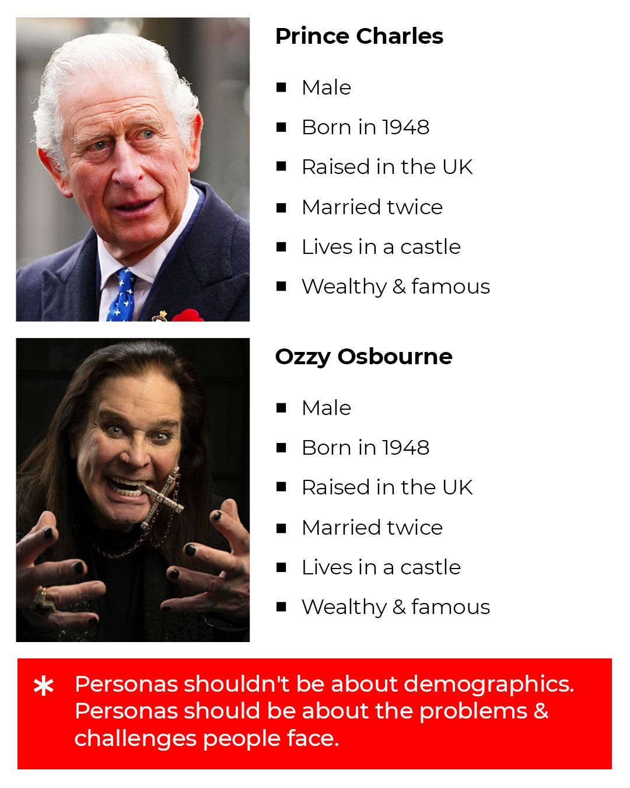

Slide 17
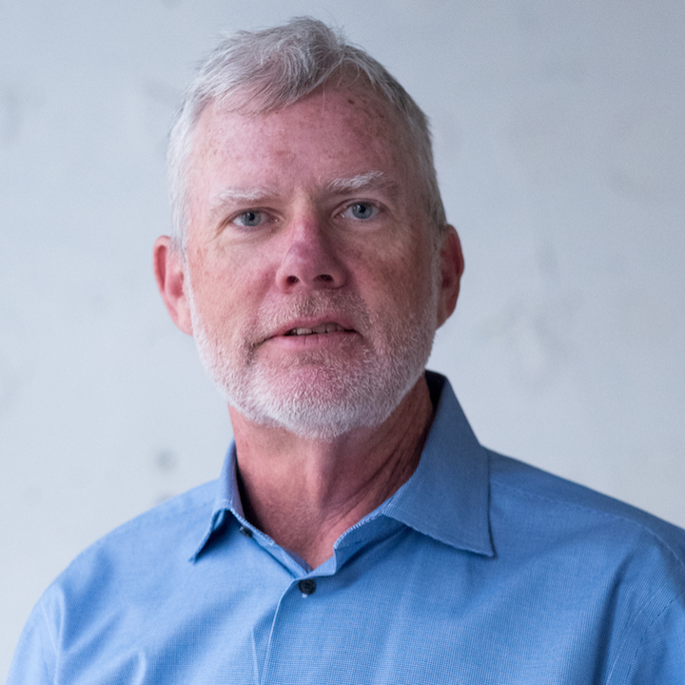
PERSONA 1:
SALES LEADER
Decision Makers:
VPs, Directors, Heads of
Title examples:
Vp of Sales, Director of Business Development, Head of Outbound
Example:
Mike Sheridan, CRO at Inbox Health

Slide 18
MATERIAL GOALS
& CHALLENGES
Increase revenue year on year
Earn more money and commission
Ensure they and their team hit targets and quota
Grow the team with great people
Increase revenue share from new channels
Reach new markets
Increase their team’s satisfaction
Convert more marketing leads to sales
Example:
Mike Sheridan, CRO at Inbox Health

Slide 19
SPIRITUAL GOALS
& CHALLENGES
Help the companies they sell to succeed
Great alignment between sales, marketing, and other departments
Ensure their team are happy and that they can see opportunities at the company
Best reps getting stolen by competitors
Getting involved in the detail too much and not empowering their team
Make sure customers are happy and loyal
Example:
Mike Sheridan, CRO at Inbox Health

Slide 20
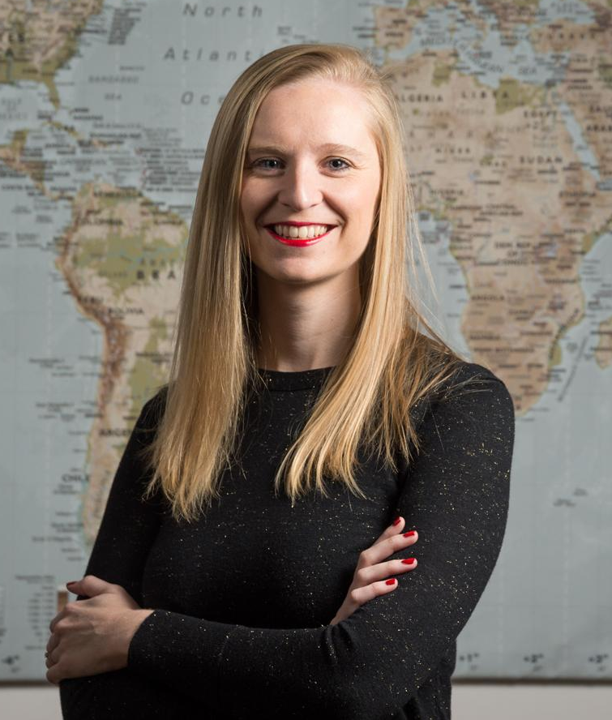
PERSONA 2:
MARKETING LEADER
Decision Makers:
VPs, Directors, Heads of
Title examples:
VP of Marketing, CMO, Head of Marketing
Example:
Flo Broderick, Carto

Slide 21
MATERIAL GOALS
& CHALLENGES
Increase conversion rates of inbound leads
Conversion rates currently low as sales team giving up easily and don’t understand marketing campaigns
Produce clear ROI from marketing campaigns
Increase revenue share from marketing
Attribute more results to marketing as difficult to clearly attribute results to marketing efforts despite revenue increasing
Increase average seal size of marketing generated revenue
Example:
Flo Broderick, Carto

Slide 22
SPIRITUAL GOALS
& CHALLENGES
Organize content well so that all departments understand it
Sales team don’t appreciate their content, don’t use it and don’t understand how it can make their lives easier
General misalignment with sales is demotivating for marketing team
Align with sales, and have sales and marketing working together as one revenue engine towards a common mission
Managing business development team and outbound is not their area of expertise
Example:
Flo Broderick, Carto

Slide 23

WHAT OPEN ENDED QUESTION CAN YOU ASK?
That can help uncover the challenges of your buyers relevant to your service?
Open ended questions rather than yes or no questions help open up your prospect more and get more info out of them. These can be used both on cold calls and discovery calls

Slide 24
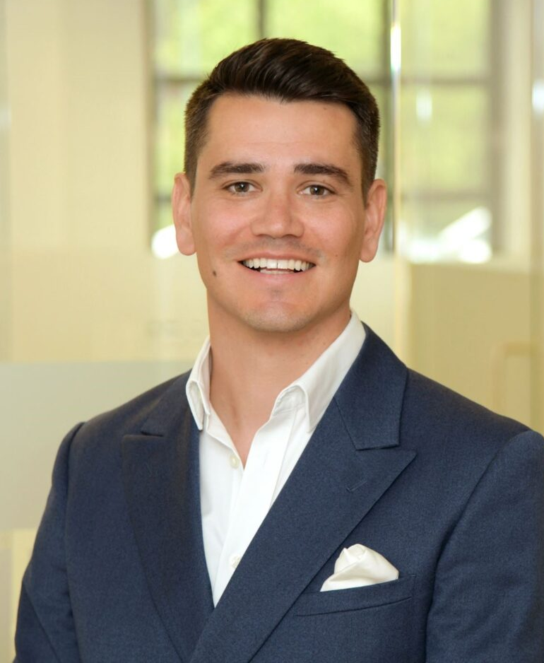
PERSONA 3:
CEO/FOUNDER
Title examples:
President, CEO, Founder, Co-founder, Managing Director
Example:
Aurelien Mottier, Operatix

Slide 25
MATERIAL GOALS
& CHALLENGES
Year on year growth
Being cash flow positive as a business
Bring in new funding to the company
Increase customer retention rate
Increase employee retention rate
Increase customer satisfaction
Increase employee satisfaction
Seeing consistent results and pipeline from sales team
Example:
Aurelien Mottier, Operatix

Slide 26
SPIRITUAL GOALS
& CHALLENGES
Driving towards their mission and vision
Keeping departments aligned and happy
Getting involved in sales too much and not empowering their own team
Keep staff & customers happy and have them believe in their mission and vision
Best employees getting stolen from competitors
Not able to focus on mission strategy enough as getting pulled into the weeds in different departments
Example:
Aurelien Mottier, Operatix

Slide 27

PROBING
QUESTIONS
How to ask open ended questions to uncover your buyer’s challenges

Slide 28
QUESTIONS ABOUT
THEIR SALES TEAM
How are you assessing if your sales team believe in the company’s mission so they believe in what they sell?
How are you keeping your sales team happy so they are not poached by competitors or want to move into a different role?
How are you ensuring top reps don’t want to become AEs too soon?
How long does it take you to train and onboard new sales people?

Slide 29
QUESTIONS ABOUT
THEIR PROCESS
How many touch points do you use in your cadences?
Do any of your SDRs have call reluctance?
Which technologies do you use to implement cadences?
How are you currently ensuring your sales messaging is relevant and personalised to your prospects?
What sales channels are you using at (company name) to generate consistent pipeline?

Slide 30
QUESTIONS ABOUT
THEIR GOALS & TARGET OUTCOMES
What are your quarterly or monthly targets for your sales team?
How close are they to achieving them?
Aside from commission and salary, what else is important to your team?
Have you run successful outbound programs at (company name) in the past?

Slide 31

POWER STATS
Industry statistics that frame problems and educate your buyers

Slide 32

SALES OUTREACH
POWER STATS
82% of CEOs said their sales organization had a poorly defined process or a process that wasn't being followed
(Thinktraining)
Only 18% of buyers trust and respect salespeople (Roundup)
48% of salespeople are afraid to pick up the phone and make cold calls (Gartner)
On average it takes 10-14 touches to book a meeting with a cold lead, which means SDRs need motivation and belief to stay persistent
There is 4x increase in reply rates from LinkedIn voice notes vs. written LinkedIn messages
There is a 74% increase in contact rates when making at least 6 cold calls
Reps doing 20-30 touches vs 10-20 touches get twice as many meetings
The average open rate for a cold SMS is 90% vs 20% for a cold email.
Using video as part of your outreach strategy can increase your open rates by 16% and increases your reply rates by 26%

Slide 33
SALES OUTREACH
POWER STATS ‘24
57% of sales professionals report the number of touchpoints needed to close deals has increased over the past year
57% of sales professionals are using custom videos as part of their sales process
64% reps using videos report increased reply rates
41% reported an increase in close rates
74% reported they’d maintained or increased productivity since using video
76% of sales professionals have adopted a structured sales cadence to guide them in reaching out to new prospects, but 42% see “connecting or booking meetings with potential customers” as their biggest challenge
40% of sales professionals report the number of stakeholders involved in the buying process has increased over the last year
Just 7% of sales professionals are using a cadence of more than 21 touches
53% of sales professionals report it has become harder to reach buyers over the past year

Slide 34

SALES RETENTION
POWER STATS
It takes 150-200% of a sales rep’s salary to replace them (Xactly)
SDR attrition rate is 36% a year and it takes 4-6 months for an SDR to ramp up and be fully productive (The Bridge Group)
Sales reps who strongly believe in their company's purpose are almost 3x more likely to exceed quota
(Sales Executive Council)
Nearly ⅔ of American employees said that the COVID-19 pandemic has caused them to reflect on their purpose in life (McKinsey)
It takes 6 months on average to replace a sales rep (Xactly)
70% of employees said that their sense of purpose is defined by their work (McKinsey)
44% of sales reps are planning to leave their jobs within 2 years (Xactly)
Average sales rep tenure is only 18 months (Xactly)
58% of companies have higher number of sales team turnover than 2020 (Xactly)

Slide 35
OUTREACH GUIDELINES
Compelling, relevant messaging to generate curiosity

Slide 36
OUTREACH GUIDELINE: SALES LEADERS HIRING SDRS
*Throughout these slides always choose the most relevant customer story to the company you’re targeting
CHALLENGE OR GOAL | PROBING QUESTION | VALUE PROPOSITION / POSITIONING STATEMENT
Time it takes to on board and train new sales people and attrition rate after all that work | The average SDR attrition rate is 34% a year and it takes 4-6 months for an SDR to ramp up and be fully productive, which is time wasted if they churn after. How do you train and onboard new salespeople to stay motivated and believe in your mission? | We train and onboard new hires and encourage them to align with their sales “why”. Working with Jorge, VP Global Sales at CARTO, our COSMIC vision saved them significant amounts of time training reps, their SDR team hit quota for the first time, they reduced attrition rates, and we helped them secure $61 million in funding.
Breaking through the noise and standing out among the automated email and LinkedIn spam | VPs like yourself receive tons of spam, so it’s hard for your team, and disheartening when they get no responses. How do you train your SDRs to break through the noise? | Dan Hebert, VP Sales, and his team at Proposify generated almost all their revenue from inbound, and they were getting discouraged by 0 results from outbound. Now over 50% of their pipeline is generated from outbound activities after the training, coaching and a standardised playbook we provided.

Slide 37
OUTREACH GUIDELINE: SALES/MARTECH
*Throughout these slides always choose the most relevant customer story to the company you’re targeting
CHALLENGE OR GOAL | PROBING QUESTION | VALUE PROPOSITION / POSITIONING STATEMENT
Marketing tech is sold to marketing leaders and they can be difficult to get on the phone (3% connect rate vs 10% for sales leaders). | We’ve noticed that marketing leaders pick up their phone less than other personas and it’s disheartening for SDRs to hear voicemails all the time. What are you finding is the best way to get their attention? | As marketing leaders can be difficult to reach, we design multi touch cadences combining various channels to increase contact rates, and train SDRs how to use them to ensure they don’t spend all day listening to voicemails Working with Proposify, we helped them generate 6X more qualified meetings from outbound activity, and created 3 sales superstars and LinkedIn thought leaders.
Sales/Martech is a rapidly growing industry and it can be hard to stand out from all the noise, which is disheartening for SDRs, who you want to help as a CRO | The sales/marketing technology space is growing exponentially and sales/marketing leaders are being inundated with hundreds of prospecting emails and LinkedIn messages a day. How are you breaking through the noise? | As (Martech) is a convoluted space, we design and transform your cadences to align to the higher purpose of your ideal customers, and then train your SDRs how to use them, aligning them with your mission. Working with Proposify, we helped them generate 6X more qualified meetings from outbound activity, and created 3 sales superstars and LinkedIn thought leaders.

Slide 38
OUTREACH GUIDELINE: MARKETING LEADERS
*Throughout these slides always choose the most relevant customer story to the company you’re targeting
CHALLENGE OR GOAL | PROBING QUESTION | VALUE PROPOSITION / POSITIONING STATEMENT
Low conversion rate of marketing leads into sales opportunities due to a lack of understanding by the sales team of your work | I noticed on your website, that you have lots of great content, and also that you have Outreach, which I imagine you use to convert MQLs into sales opps. How are your sales team converting your MQLs into qualified sales opps on Outreach? | Flo Broderick, VP of Marketing at Carto, managed the SDRs and had no SDR manager so was struggling to motivate them to do more outbound. After we helped their SDRs find their why, we coached and trained them to hit quota for the first time, convert more MQLs into deals, and they have been a client ever since.
Not enough touchpoints from sales to convert marketing leads into revenue. Sales complain about quality but it’s also a will issue on their side due to call reluctance and lack of motivation | I see you have lots of great content at (company name), but sometimes it can be difficult to ensure the sales team use this content effectively in their outreach. What’s your strategy to ensure the sales team use your content effectively? | Omer Primor, VP of Marketing at Imvision managed the SDRs and had no SDR manager so was struggling to motivate them to do more outbound and touchpoints on MQLs, which they were investing a lot in generating. After we helped train and motivate their SDRs behind their vision, they added more call and video steps to sequences, and generated 61% more meetings from outbound.

Slide 39
OUTREACH GUIDELINE: SALES OUTSOURCING FIRMS
*Throughout these slides always choose the most relevant customer story to the company you’re targeting
CHALLENGE OR GOAL | PROBING QUESTION | VALUE PROPOSITION / POSITIONING STATEMENT
Clients have unrealistic expectations which can lead to a lot of pressure on managers and SDRs, who already have a stressful job in outsourcing | I worked in sales outsourcing for 4 years so I know how difficult it can be to hit client targets and keep the churn rate low with both clients and staff. How are you currently achieving this at (company name)? | Our playbooks and cadences have enabled Operatix, another sales outsourcer in Europe and the US, to decrease onboarding time by 78%, and as importantly enable their managers to be less stressed, whilst increasing client renewal rates.
Training and onboarding reps for new accounts takes management a huge amount of time and effort, in what is already a stressful job with tough client expectations | We appreciate sales outsourcing is a tough gig with unrealistic client expectations so you want to hit the ground running. How long does it take you to train and onboard sales reps when you sign up a new account? | Working with lead gen company Demand Zen, after 2 days of setting up the process for one of their accounts, they had already generated 4 qualified meetings, which helped lead to a renewal and expansion. This was a big weight off the shoulders of the COO and account management team, and of course helped the SDRs feel more fulfilled in their roles.

Slide 40

QUALIFYING
QUESTIONS
Supplementary questions to identify qualified opportunities

Slide 41
QUESTIONS THAT WILL CLARIFY IF THE LEAD IS A GOOD FIT
These are a secondary check if necessary. Often a lot of this information can be found with prior research. The probing questions are what will be initially used to uncover business needs.
However, do always try to confirm if anyone else should be involved in the discussion when confirming next steps with the last question.

Slide 42
QUALIFYING QUESTION: EXAMPLES
How big is your sales team?
Do you use any call recording or sequencing tools?
Who’s involved in the sales strategy decisions at (company name)?
Have you run successful outbound programs at (company name)?
How well have you defined your ideal customer profile?
Is there anyone else on the team who should be involved in this discussion?

Slide 43

UNDERSTANDING
OBJECTIONS
Acknowledge and understand vs overcoming objections

Slide 44
OBJECTION
QUESTION TO CLARIFY
Listen closely to identify the objection and don’t interrupt.
Ask questions to clarify the TRUE objection before you attempt to handle it.
You’re expensive
I understand (first name).
Do you mind me asking what your average deal size is?
It’s not the right time
I understand (first name). What are your top priorities at the moment?

Slide 45
OBJECTION
QUESTION TO CLARIFY
Listen closely to identify the objection and don’t interrupt.
Ask questions to clarify the TRUE objection before you attempt to handle it.
We’re using a competitor already
Understood (first name). How’s that working out for you?
We don’t need help with sales and are doing it successfully
That’s great to hear (first name). What’s working well for you?

Slide 46
OBJECTION
QUESTION TO CLARIFY
Listen closely to identify the objection and don’t interrupt.
Ask questions to clarify the TRUE objection before you attempt to handle it.
We don’t want to work with an external team. We’re planning to do it in-house
I understand (first name). What does your process look like for internal training?
It’s my job to do this and I don’t need outside help
I understand (first name). What’s your personal process for training/coaching/cadences/playbooks?

Slide 47
DISCOVERY &
SALES PROCESS

Slide 48
SALES PROCESS: 1st Scheduled Call - Pre-Call Preparation 5-10mins
Personal Research: find something specific you can use to build rapport at the beginning of the call versus something generic about the weather or an anecdote about where your prospect lives.
Check the company website, company LinkedIn page and the person’s LinkedIn to find a trigger, for example: “Martin, saw your post about …”
Company Research: research the other likely stakeholders at the company, so when it comes to discussing next steps at the end of the call, you can build credibility by already being aware of who might need to be included in the next call.

Slide 49
SALES PROCESS: 1st Scheduled Call - Build Rapport and Set the Agenda 5mins
Build rapport with something specific versus something generic about them
Check the company website, company LinkedIn page and the person’s LinkedIn to find a trigger you can talk about at the start of the call, for example: “Sarah, saw (company name) just launched XYZ product. Must be an exciting time to be leading the sales team…
Set a short agenda for the call:
We’ll start with understanding what you’re looking to achieve and where your challenges are at the moment.
Then we’ll show you what we do at Cosmic Growth and tell you about some of our customers
If we both see a good fit here, we can arrange another call
How does that sound to you?

Slide 50
SALES PROCESS: 1st Scheduled Call - Discovery Questions 10-15 mins
Example questions that will help uncover the challenges the buyer is trying to solve and the goals they’re trying to achieve:
On average it takes 10-14 touches to book a meeting with a cold lead - how many touches are your SDRs giving each lead at the moment?
Sales reps who strongly believe in their company's purpose are almost 3x more likely to exceed quota - how invested would you say your team is in (company name)’s mission and vision?
What’s the balance at the moment between inbound and outbound-generated opportunities?
How is your sales team structured? SDR/AE? Full-cycle?
Why not stick with the status quo? What would the impact be on your sales Team?

Slide 51
SALES PROCESS: 1st Scheduled Call - Value Proposition 10-15mins
Value Proposition: Structure
Outline Cosmic Growth’s services and how they can help the prospect to solve the challenges outlined in discovery, as well as reach their goals.
Set out the mission and vision of Cosmic Growth, our history and the reason Mikey set up the company.
Run through the Cosmic Growth Playbook and Cadence, but make it interactive:
  What are some of your triggers/personas?
  How aligned are your reps on what the key triggers and personas are?
  How does this compare to what you have in place at the moment?
  Outline the most relevant customer story to their industry, use case, goals and ask them how they are using customer stories?
(Always research the company before the call so you have some relevant case studies prepared)
Ask how do they see the playbook and cadences fitting into their plans to reach the goals identified in discovery

Slide 52
SALES PROCESS: 1st Scheduled Call - Qualifying Questions 5mins
Are there any other solutions you’re looking at currently to solve (insert pain from discovery)?
Who else is involved in sales enablement at (organisation)? Who runs the SDR team?
What’s the criteria you’re using to make your decision? Which of those criteria would be your top priority?
What’s your evaluation process?
How do you see yourself using this (if at all)?
Is this something you’re looking at starting soon or it’s more of a next quarter project?
Is there any consequence associated with that timeline?

Slide 53
SALES PROCESS: 1st Scheduled Call - Next Steps 5mins
If they’re interested, always book in a follow-up call and state:
As a next step, let’s arrange a call where we can review your goals for the project and walk you through a training and coaching proposal.
You mentioned [Jane and Johnny] will also be interested; would you like to invite them to the next call?
How does [Monday afternoon] look for you?
Send them a follow-up email within (at most) 24hrs of the call, summarising the challenges they outlined and a relevant customer story

Slide 54
SALES PROCESS: 2nd Scheduled Call - Proposal Review 10-15mins
Give an agenda for the call to start and summarise what was discussed in the 1st call and then:
Run through the training and coaching proposal but make it interactive:
  How does this implementation timeline look to you?
  How does this compare to what you’re doing now?
Once you’ve been through the proposal, ask “how does this all fit into what you want to achieve?”

Slide 55
SALES PROCESS: 2nd Scheduled Call - Project Goals 5mins
Outline some measurable aims and metrics for their project which we can use to benchmark their success:
X % increase in pipeline
SDR’s hit target by Q3
X Demo’s booked/attended per month/Q
New SDR’s ramped by EoM 1
X Qualified Meetings booked/attended per month/Q
X % increase in Average Deal Size
X % decrease in no-show rate

Slide 56
SALES PROCESS: 2nd Scheduled Call - Pricing 5mins
Value Proposition: Structure
Pricing: Structure
Never ask “what’s your budget?”...instead:
State pricing and ask “...how does that sound?”
If you suspect pricing could be an issue, ask “...does that sound like a crazy amount given your situation?”
Playbook £k
Training & Coaching £k (X Groups of Y SDR’s/AE’s)*
£k (X Groups of Y SDR’s/AE’s)*
All pricing is bespoke based on … .
*Note: use the prospect company’s terminology, e.g. BDM/BDR/AE/SDR etc

Slide 57
SALES PROCESS: 2nd Scheduled Call - Next Steps 5mins
If there’s interest, always book in a follow-up call and state:
As a next step, we’ll carry out an audit of one of your existing cadences, and we can and we can review it on a second call.
How does [Wednesday morning] look for you?
Send them a follow-up email within (at most) 24hrs of the call, summarising the call and sharing the proposal, with any changes discussed during the call.

Slide 58
SALES PROCESS: 3rd Scheduled Call - Audit
Give an agenda for the call to start and summarise what was discussed in the previous call and then:
Run through the audit but make it interactive (e.g. “how do you see your team using this?”)
Establish what are the remaining barriers to getting the project signed off.
Book a follow up call to discuss a potential start date and talk through the legal agreement

Slide 59

CUSTOMER
STORIES
How we’ve solved these problems for other customers in similar situations
Further customer stories can be found here

Slide 60

There is no story without a villain…
Notes:
Mikey

Slide 61

CUSTOMER STORY - REAL ESTATE
CHALLENGE | SOLUTION | RESULTS
Looking to generate momentum through outbound during the typically slow summer period, and get traditional brokers engaged in outbound | Designed a sales playbook bespoke to commercial real estate, plus industry- and topic-specific cadences and talk tracks, as well as group and 1-1 training & coaching | - Brokers adopted new tactics, strategies and channels to reach and engage with prospects - Huge increase in meetings and revenue opportunities during what’s usually a quiet time - Brought to light the need to support brokers with materials, tools and tactical advice on how to develop relationships and research clients - Brokers felt inspired to go out and make calls

Slide 62

CUSTOMER STORY
CHALLENGE | SOLUTION | RESULTS
A UcaaS that operated almost purely off inbound leads and had never had success generating or closing | A full sales audit, designed a personalised sales playbook to guide outbound efforts, and 1-1 coaching with reps and managers | - Landed global retailers from outbound - Larger deal size - Larger % of revenue from outbound

Slide 63

CUSTOMER STORY - REAL ESTATE
CHALLENGE | SOLUTION | RESULTS
Wanted to improve the skills, effectiveness and satisfaction of both their junior and senior brokers in the Atlanta office | A full sales audit, designed personalised talk tracks, messaging and cadences and a complete playbook, coupled with regular 1-1 training and coaching with reps and managers | - Cresa’s revenue in the Atlanta office was up 20% to 25% in 2024 - More collaboration and teamwork came out the training than ever before - The Industrial Group is now seeing great success in portfolio business - The senior reps were very energised from the training

Slide 64
CUSTOMER STORY - REAL ESTATE
CHALLENGE | SOLUTION | RESULTS
Looking to generate momentum through outbound during the typically slow summer period, and generate pipeline for their industrial brokers | Designed a sales playbook bespoke to supply chain and warehouse stakeholders plus industry- and topic-specific cadences and talk tracks, as well as group and 1-1 training & coaching | - 450+ brokers participated (approx. 50% of US Office Tenant Rep) - Larger average deal size due to better opportunities created with high value prospects - Generated $410M revenue of pipeline

Slide 65

CUSTOMER STORY - FINTECH
CHALLENGE | SOLUTION | RESULTS
Young team lacking understanding of what their messaging should be or how to be consistent and repeatable in prospecting for consistent results | A full sales audit, designed a personalised sales playbook to guide outbound efforts, and 1-1 coaching with reps and managers | - 43% increase in opportunities and 53% increase in revenue across the entire new business funnel - 40% increase in revenue from Key Accounts (enterprise) team - New business manager able to step away from the sessions and focus on other priorities

Slide 66

CUSTOMER STORY - FINTECH
CHALLENGE | SOLUTION | RESULTS
Inexperienced SDR team lacking in confidence. Needed some support to become a strong outbound engine for the business | A full sales audit and interviews with management and other stakeholders. Designed a personalised sales playbook to guide outbound efforts, and 1-1 coaching with reps and managers | - Total opportunities and average deal size both increased - SDR team average deal size increased by 25% - Repeatable onboarding process created for new SDRs, enabling ramp to productivity within 3 months - SDR team feeling the support and investment of the business/leadership

Slide 67

CUSTOMER STORY - MARKETING & SALES TECH
CHALLENGE | SOLUTION | RESULTS
Operated almost purely off inbound leads and had never had success with outbound | A full sales audit, designed a personalised sales playbook to guide outbound efforts, and 1-1 coaching with reps and managers | - From 5% outbound sales to 50% of pipeline - 6X more qualified outbound meetings booked - Saved them 10 hours per week on coaching - 50% of SDR team promoted during our work together - Will Aitken, an AE, became an established sales authority on LinkedIn and TikTok

Slide 68

CUSTOMER STORY - BIG DATA
CHALLENGE | SOLUTION | RESULTS
Had struggled to create relevant, targeted outbound messaging and programs in the past | A full sales audit, designed personalised talk tracks, messaging and cadences , and 1-1 coaching with reps and managers | - From 10% outbound to a fully fledged outbound program - Sales team hit quota for the first time - Larger average deal sizes with better opportunities - Promotions from people we trained and coached

Slide 69

CUSTOMER STORY - SALES OUTSOURCER
CHALLENGE | SOLUTION | RESULTS
Wanted to increase renewals. Had struggled to effectively build relevant messaging for channels like linkedin and email | Full understanding of the accounts we worked with, designed specific messaging for each account, and 1-1 coaching with their management team | - 1 account went from booking 1 meeting in 107 hours to 3 in 27 hours - Another account increased meetings booked by 33%, leading to a renewal - 3 additional accounts renewed following our work - Saved their managers from having to micromanage every project and team

Slide 70

CUSTOMER STORY - HEALTH TECH
CHALLENGE | SOLUTION | RESULTS
Struggled with outbound. Needed to book more meetings and make better use of the sales technology they had adopted | Sales playbook development and implementation of best sales practices. Building custom sales cadences and rep coaching | -48% increase in meetings booked for new opportunities -15% increase in discovery call attendance - Increase in lead quality, rep productivity and revenue - Larry Laconi became a top performer and was promoted to SDR manager leading 10+ SDRs

Slide 71

CUSTOMER STORY - CYBERSECURITY
CHALLENGE | SOLUTION | RESULTS
Struggling to generate meetings with security leaders. Using a spray and pray approach | Developed structured messaging for their ideal customers. Sales coaching to enable the team to have more sales conversations to generate pipeline | -61% increase in qualified meetings booked -2x open and click-through rates on cold email campaigns -Solid foundation for future scalability - Bought by Intuit for $60 million

Slide 72

CUSTOMER STORY - SALES OUTSOURCER
CHALLENGE | SOLUTION | RESULTS
Struggling with building and developing clients go to market messaging, strategies and process | Helping Operatix’s clients get to market quicker by building cadences sequences and playbooks to enable their SDRs to efficiently generate pipeline and book more meetings | - 75% decrease in new SDR onboarding time - Sales playbook and cadences drove two expansions - Operatix leadership team no longer has to worry about the stress and headaches of messaging for new accounts

Slide 73

CUSTOMER STORY - SALES ENABLEMENT
CHALLENGE | SOLUTION | RESULTS
Had a group of SDRs that had never been trained to do SDR work and everyone was working in their own way | A full sales audit, designed personalised talk tracks, messaging and cadences and a complete playbook, and regular 1-1 training and coaching with reps | - SDRs are now steadily reaching target - There’s a lot more consistency within the team - Their team were ‘’really happy with the coaching’’ - Their SDR Manager was able to save a lot of time that could be devoted to other priorities

Slide 74

CUSTOMER STORY - FINTECH
CHALLENGE | SOLUTION | RESULTS
They didn’t have a standard process to go ‘’to look for new business’’ through outbound and they wanted to improve their inbound process | A full sales audit, designed personalised talk tracks, messaging and cadences and a complete playbook for both inbound and outbound, and regular 1-1 training and coaching with their reps | - 400% growth in outbound meetings - Converted 11% more inbound leads to pipeline which given they had hundreds of inbound leads was a huge leap - Having Cosmic Growth come in ‘’was absolutely game changing for them’’ - They view the sales playbook as their ‘’Northstar’’ document

Slide 75
There is no story without an adversary…
Notes:
Need to bring villain across to customer stories….
Salespeople often share the outcome of clients stories, but forget to share the challenges, spiritual and material…
And people want to hear about a hero who faced a similar villain to them…

Slide 76

CUSTOMER STORY - COMPLIANCE/LEGAL TECH
CHALLENGE | SOLUTION | RESULTS
Needed an outbound SDR team to support sales team. Lacked robust onboarding and training program for new inexperienced reps | Developed sales playbook, cadences, and call talk-tracks, alongside the training and coaching work to ramp new reps | - 100+ demos booked in 1 month with a team of 10 new SDRs - Nearly 600 demos booked in just under 5 months - New SDRs trained and on the phone in under 1 week - Helped 10 SDRs who were all under 24 understand the why of outbound and be inspired, half of whom were promoted

Slide 77

CUSTOMER STORY - MANUFACTURING TECH
CHALLENGE | SOLUTION | RESULTS
Were developing an SDR team for the first time. Traditionally heavily reliant on inbound | A full sales audit, designed a personalised sales playbook to guide outbound efforts, and 1-1 coaching with reps and managers | - Closed 7 figure deals thanks to opps generated - New SDRs delivered 2X more opportunities quarter-by-quarter - More leads qualified into opportunities than before - Time freed up for higher priority tasks

Slide 78

CUSTOMER STORY - EDUCATION TECHNOLOGY
CHALLENGE | SOLUTION | RESULTS
Were looking to both improve the performance of their Account Executive (AE) Team, as well as employee satisfaction and retention. | Developed an Account Executive (AE) sales playbook, cadences, and call talk-tracks, which was followed with regular training and coaching sessions for their AEs | - Their conversion rates are up year over year - Feedback and engagement from the AEs has been exceptional - Their sales team is having a great year - ‘’The team all acknowledges that we’re investing in their growth, that we’re demonstrating that we’re willing and able to contribute to their skill development, to making them better.’’

Slide 79

CUSTOMER STORY - BLOCKCHAIN SOFTWARE
CHALLENGE | SOLUTION | RESULTS
Were struggling to make the time to train and coach their Customer Success Team effectively | Developed a Customer Success playbook, cadences, and talk-tracks, as well as ran an extensive training and coaching program for their customer success reps and manager | - Customer Success Manager closed a huge deal during the training process - The feedback from the team was always exceptional - Another junior team member is now fully confident and on target to exceed quota 3 quarters running

Slide 80
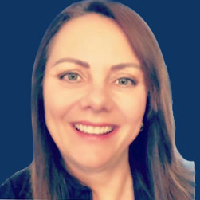
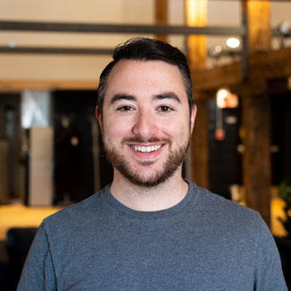
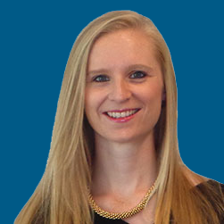

EMPOWERING B2B SALES TEAMS
Lynn Wik
VP of Service Delivery, DemandZEN
Daniel Hebert
VP of Sales, Proposify
Florence Broderick
VP Marketing, CARTO
“After working with Michael and a few other people within Cosmic Growth, we had four meetings in two days. That really lowered our hours per meeting set, which is a great value to us.”
“Cosmic Growth are the experts. We wouldn’t be where we are today on our outbound journey if it wasn’t for the playbooks Cosmic Growth put in place for us.”
“Moving completely away from the idea of pitching our products and location intelligence – has been a really good shift in mindset for us, thanks to Cosmic Growth.”

Slide 81
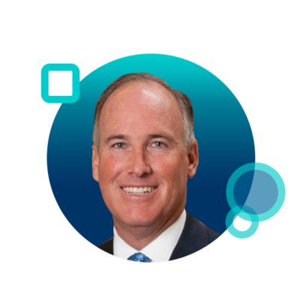
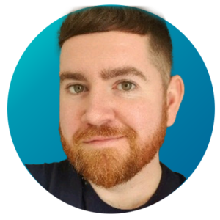
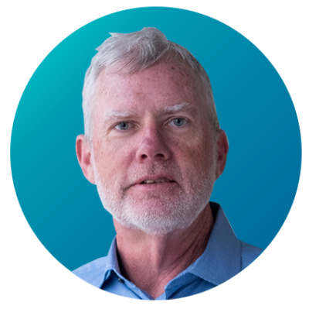
EMPOWERING B2B SALES TEAMS
Tom Maloney
Executive Managing Director, JLL
John McCann
Head of Practice New Business, Dext
Mike Sheridan
CRO, Inbox Health
“We decided to try Cosmic Growth as part of this program. And now reflecting back on it, it was probably one of our wisest decisions. The materials gave [our team] inspiration to go out and make calls.”
“When I think about the difference in the reps over from the first session to towards the end, it’s polar opposites. We generated 43% more opportunities across the entire new business funnel”
“Cosmic Growth are going to help you in immeasurable ways by making your results better and your life easier. I couldn’t be more pleased.”

Slide 82
www.CosmicGrowth.com

